Slide 1
EncryptNotes
Secure and Intelligent Note Management
CPT-200 Team 2 Phase 4

Slide 2

What is EncryptNotes?
Secure, AI-powered Note App
Accessed from Web Browser
Privacy & Efficiency Top priorities

Slide 3

Why EncryptNotes?
Other apps -
Lack of security
Poor organization
No automatic categorization

Slide 4

Solution
End to End Encryption
AI-Power Categorization
User-Controlled Security Setting

Slide 5
Features
Secure Encryption
AI Categorization
Note Editing and management
User account Control

Slide 6
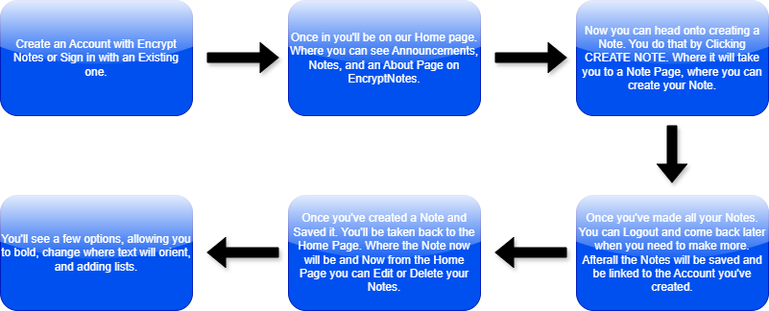
Technical Overview
Encryption
Data Encrypted Before Saving to Database
Decrypted Upon access from Database
AI Integration
Google Cloud Natural Language API
User Authentication
Secure authentication With Django

Slide 7
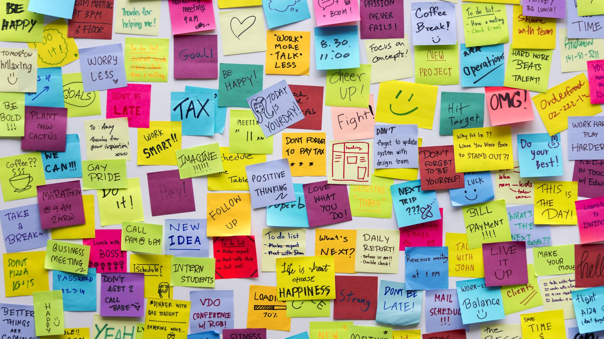
Market Opportunity
Potential Use Cases Include:
Students – secure college Notes
Business Professional – Secure Work Notes
Other Privacy Focused Individuals

Slide 8
Advantage
General Notes Apps lack encryption
Few apps integrate AI organization
Gives Users Control over Security Settings

Slide 9

Future Growth & Monetization
Growth
Mobile App
Expanded AI Capabilities
Monetization
Subscription-Based Features
Enterprise Solutions

Slide 10
DEMONSTRATION

Slide 11
Any Questions?

